Slide 1
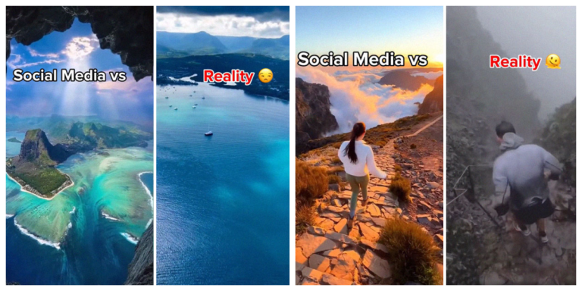
Title: "The Social Media vs. Reality"
By. Md Abu Raihan
Roll: 21, B.I.A, DDU-GKY

Slide 2
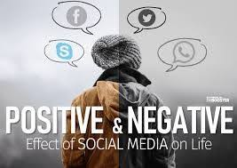
Introduction
In the age of digital connectivity, social media has become an integral part of our daily lives, influencing how we perceive ourselves and others. While these platforms provide an avenue for communication, self-expression, and connection, they also present a curated version of reality that often diverges from the complexities of everyday life. This phenomenon has given rise to a partially variance known as The Social Media vs. Reality.

Slide 3
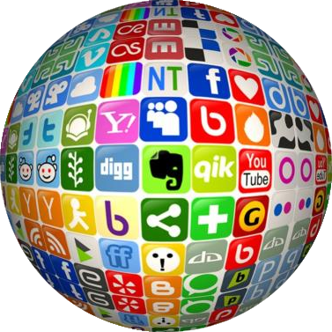
What is Social Media: social media refers to online platforms and tools that allow individuals and communities to interact, share, and create content. It enables the exchange of information, ideas, and media in a virtual environment.
Some examples of Social Media Platforms:
Facebook
Twitter
Instagram
LinkedIn
YouTube
WhatsApp

Slide 4
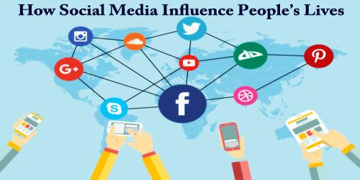
Social Media Influence
The influence of social media continues to grow day by day due to a combination of factors, including technological advancements, changing communication patterns, and the evolving nature of social interactions.
Visual Communication
Personal Branding
Impact on Education
Information Share
Global Connectivity

Slide 5
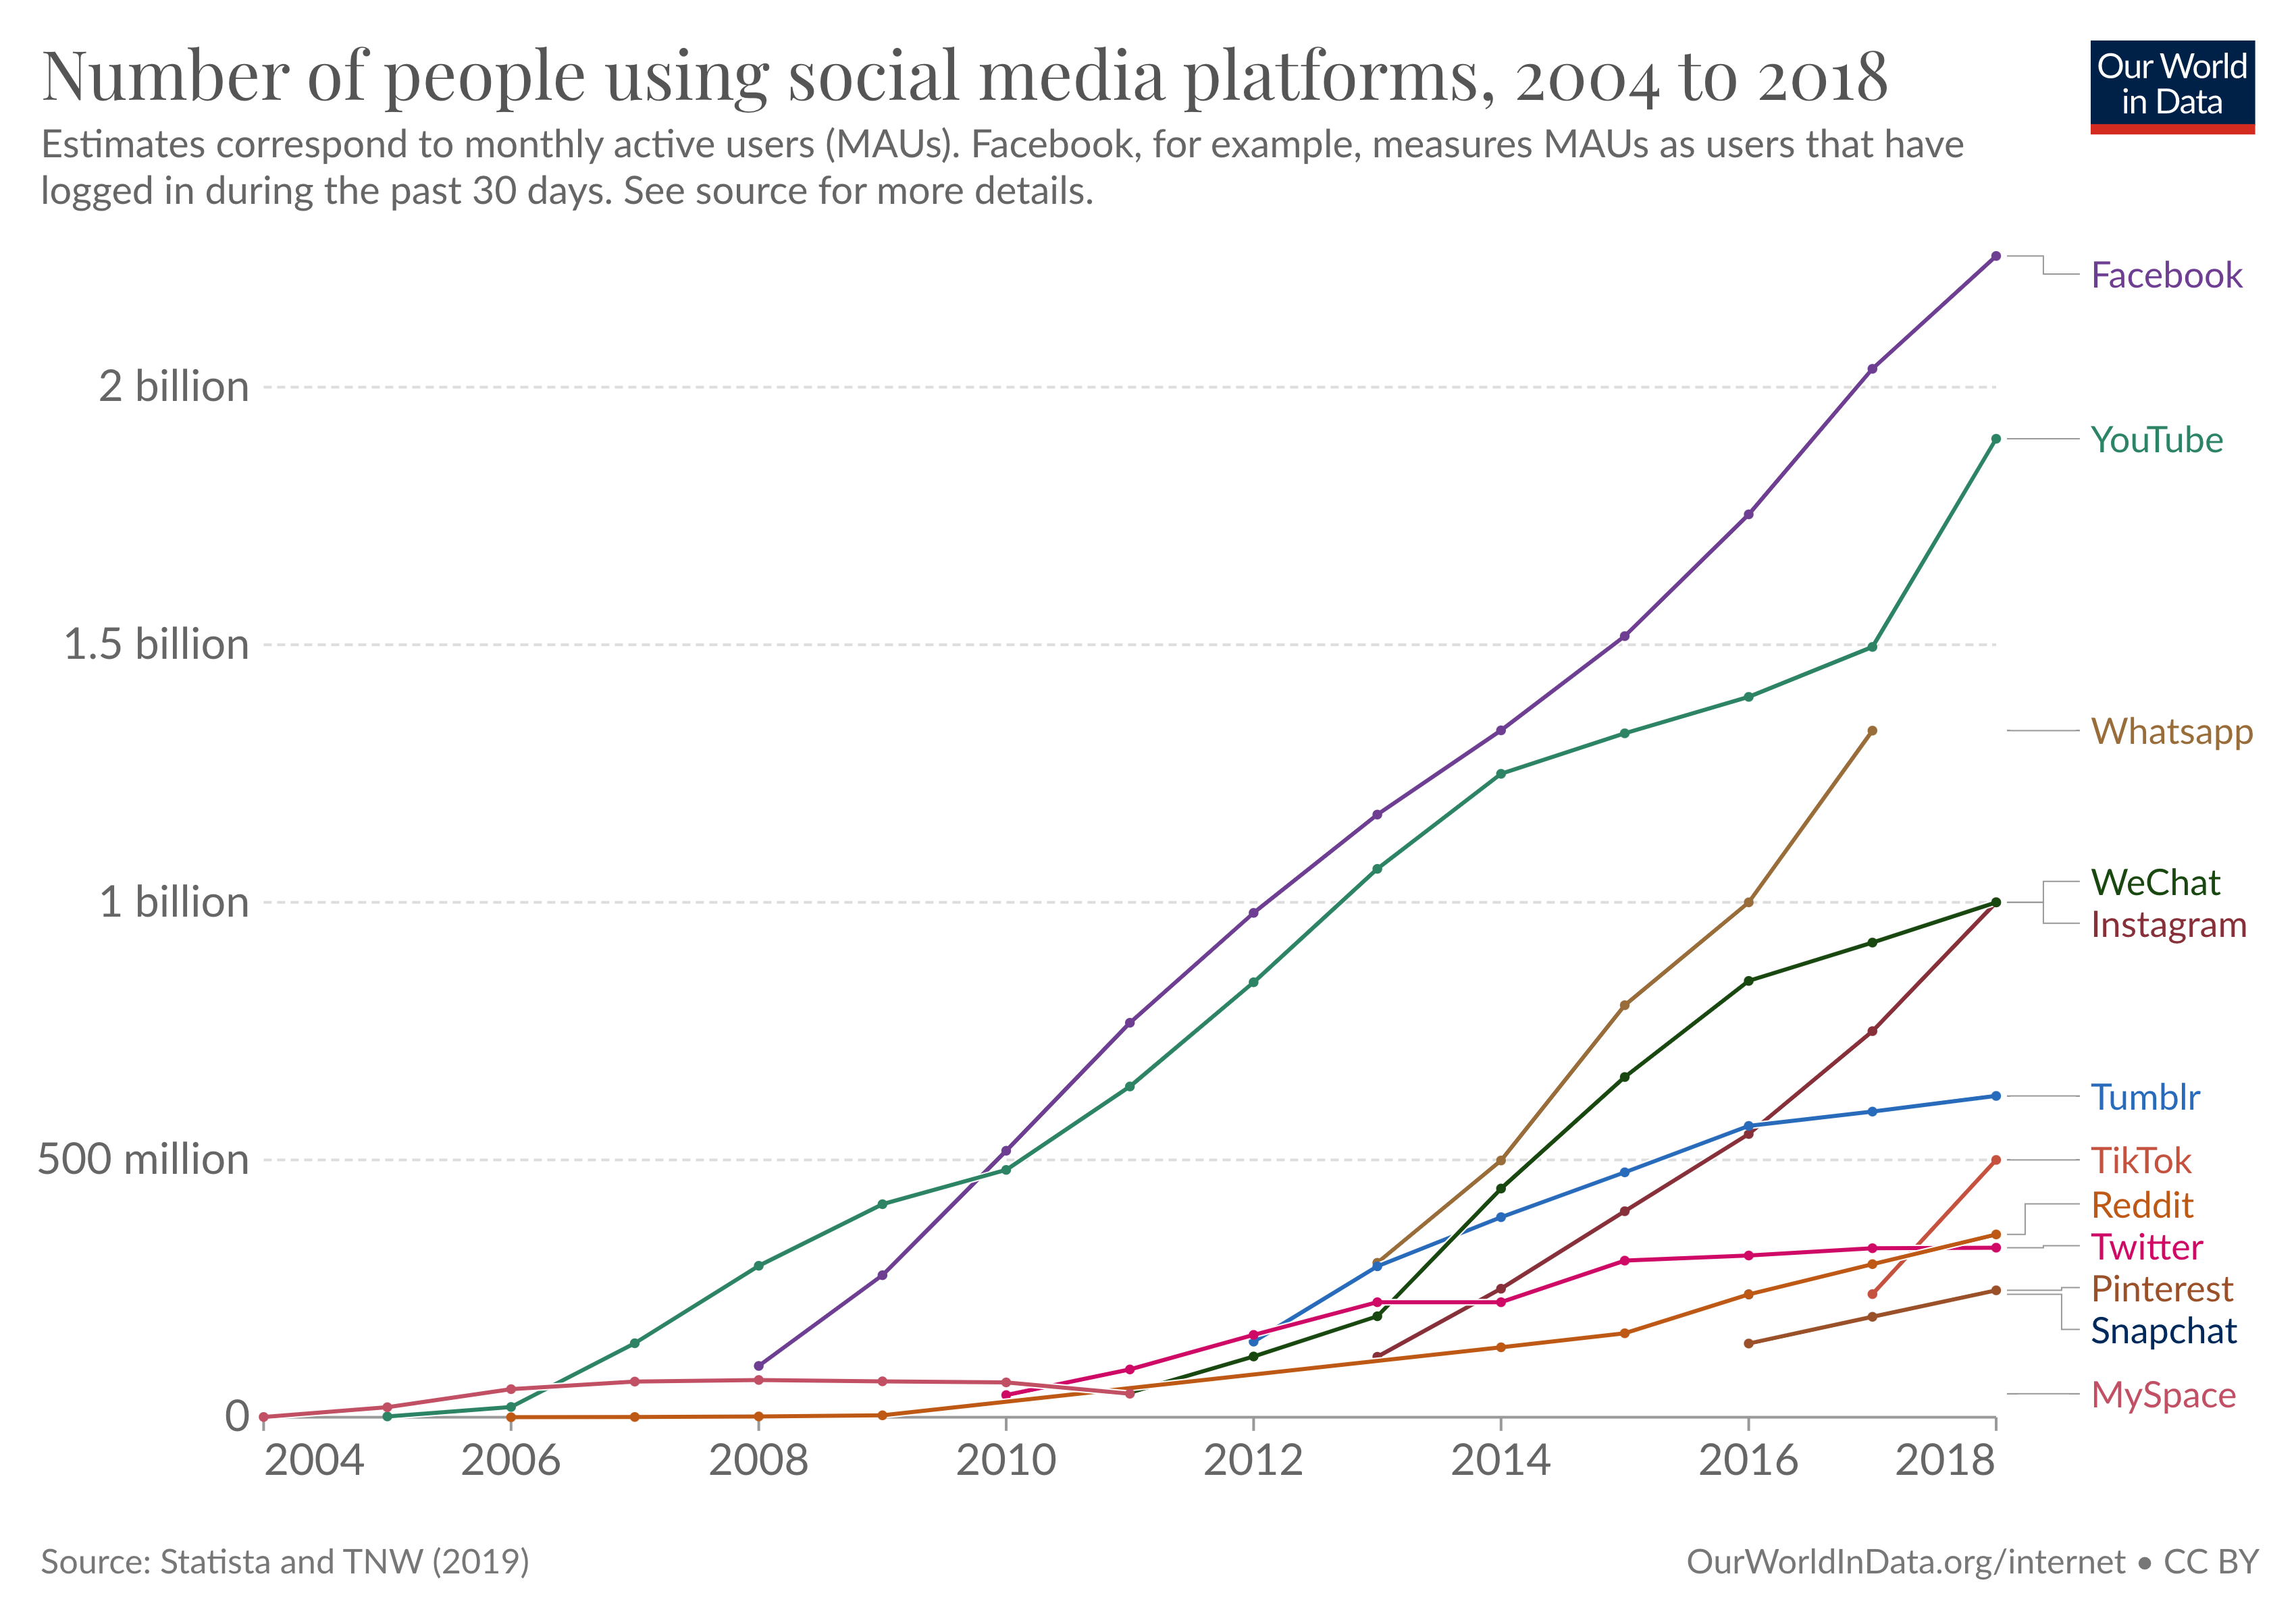

Slide 6
Positive Aspects of Social Media
Communication and Connectivity:
Information and Awareness:
Educational Resources:
Global Awareness and Activism:
Professional Networking:

Slide 7
The Reality Behind Social Media.
1. Organized content:
Social Media: Users often arranged and present an idealized version of their lives. They share the highlights, achievements,
and positive moments.
Reality: Real-life experiences are diverse and include both ups and downs.
2. Filters and Editing:
Social Media: The use of filters, photo editing tools, and other enhancements is common to create visually appealing content.
Reality: Unfiltered and unedited images may present a more authentic portrayal of situations, appearances, and surroundings.
3. Comparison Culture:
Social Media: Users may engage in social comparison, measuring their lives against others' seemingly perfect online personas.
Reality: Each person's journey is unique, and comparing oneself to others on social media may lead to feelings of inadequacy.
4. Impact on Self-Esteem:
Social Media: social media can have an impact on self-esteem, and this impact can vary from person to person.
Reality: Recognizing that social media is a selective representation of life can help in fostering a healthier self-perception.
5. Validation Seeking:
Social Media: The pursuit of likes, comments, and validation on social media may influence behavior and content creation.
Reality: Seeking validation from external sources may not necessarily contribute to genuine happiness and fulfillment.

Slide 8
The Reality Behind Social Media.
6. Cyberbullying:
Negative interactions, comments, or cyberbullying on social media can significantly harm self-esteem.
The anonymity of online platforms sometimes encourages hurtful behavior.
7. Constant Connectivity:
The pressure to be constantly connected and share updates may create stress and anxiety.
Individuals may feel compelled to maintain a certain online persona, impacting their mental well-being.
8 Effect on Mental Health:
The use of social media significantly impacts mental health. It can enhance connection, increase self-esteem, and improve a sense of belonging. But it can also lead to tremendous stress, pressure to compare oneself to others, and increased sadness and isolation. Mindful use is essential to social media consumption.
9. Fear of Missing Out (FOMO):
Fear of Missing Out (FOMO) is a phenomenon often associated with social media, where individuals feel anxiety or distress due to the perception that others are experiencing enjoyable activities, events, or opportunities without them. Social media platforms contribute to FOMO through various mechanisms, leading to negative effects on mental well-being:

Slide 9
DATA: EFFECT OF SOCIAL MEDIA
Suicide:
According to the Center for Disease Control and Prevention, In 2020, people in the US ages 10-64 had a suicide rate of 10.7 per 100,000. Suicide was a leading cause of death in the United States accounting for 48,183 deaths in 2021. Suicide rates increased by 30 per cent from 2000-2018 and declined in 2019 and 2020.
And in India:
In 2019, at least one student died by suicide every hour in India total 10, 335 students suicides last 25 years. according to the National Crime Records Bureau (NCRB).
Cyberbullying:
According to the most recent Centers for Disease Control and Prevention, data, 14.9 per cent of teenagers have experienced online bullying, and 13.6 per cent of teenagers have attempted suicide seriously.
Reference: https://en.wikipedia.org/wiki/Social_media_and_suicide

Slide 10
Here are some tips for using social media in a healthy way:
Set limits on your social media use.
Unfollow connections that make you feel bad.
Use social media for positive purposes.
Be mindful of your emotions.
Be aware of the filters and editing tools that people use to make themselves look perfect.
Remember that people's lives are not always as perfect as they seem on social media.
Use social media to connect with friends and family, not to compare yourself to others.

Slide 11
case study
A case study comparing social media representations with reality could explore various aspects of how individuals present themselves online versus their actual experiences.
Objective: To investigate the disparities between individuals' social media personas and the realities of their lives, exploring the impact on mental well-being and self-perception.
Methodology
Participant Selection:
Data Collection:
Comparative

Slide 12
conclusion
In conclusion, the study underscores the need for a holistic approach to address the complex interplay between social media and reality. It emphasizes the importance of promoting authenticity, fostering digital literacy, and providing mental health resources within the digital realm. As individuals, platforms, and societies collectively navigate this dynamic landscape, a mindful and informed approach can contribute to a healthier relationship with social media and a more positive impact on mental well-being.

Slide 13


